Slide 1
Group Python Library Assignment
Cowley
Greeff
Pretorius
Notes:
Introduce group
Next: Concept

Slide 2
Python Imaging Package
Program Concept
Acts as a photo enhancer – similar to Office Picture Manager
User can manipulate an image by choosing menu commands
Each command alters picture
Notes:
Acts as a photo enhancer – similar to Office Picture Manager
User can manipulate image by choosing menu commands
Each command alters picture
Next run sequence

Slide 3
Program run Sequence
Picture File is selected via user input
Menu pops up asking what enhancement/filter the user wants
Notes:
Picture File is selected via user input
Menu pops up asking what enhancement/filter the user wants
Next : menu view

Slide 4
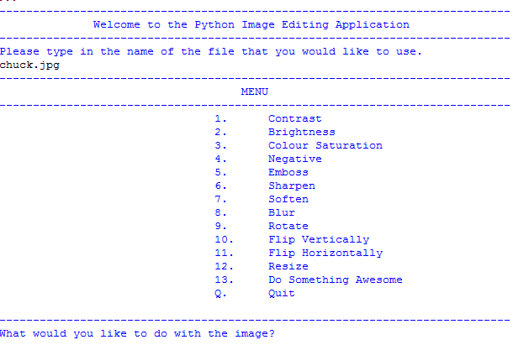
Notes:
Next: composition

Slide 5
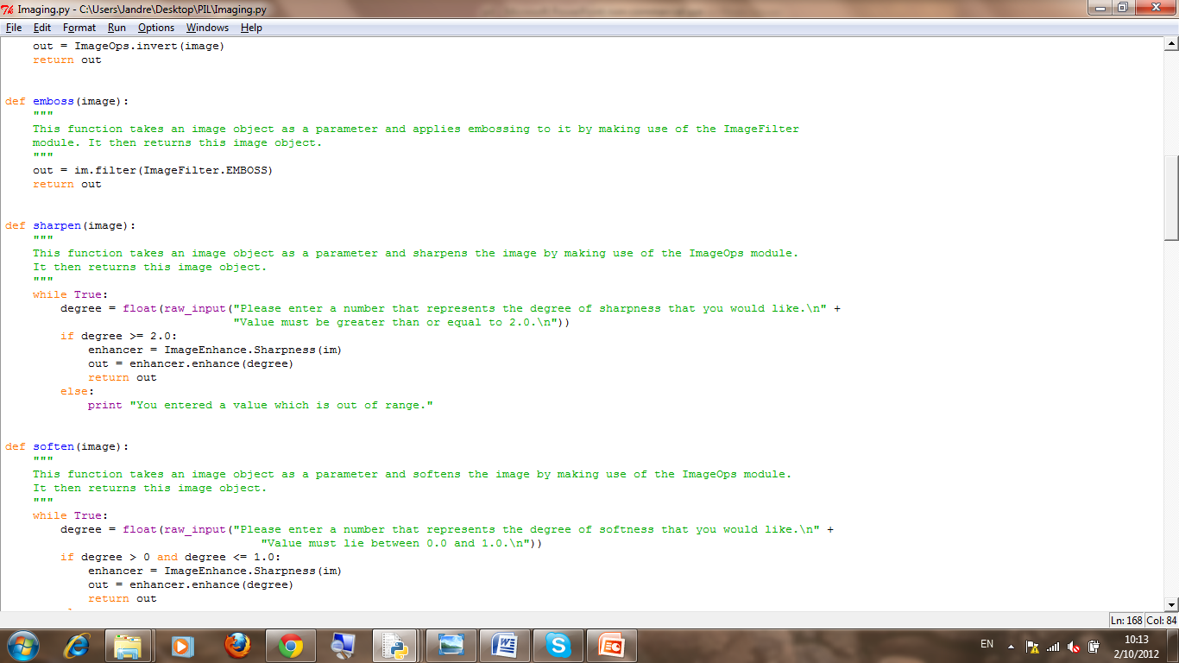
Program Composition
The program uses several functions
Each function is a different filter/effect/etc.
When a user selects a menu option, the appropriate function is called to perform the alteration.
Notes:
The program uses several functions
Each function is a different filter/effect/etc.
When a user selects a menu option, the appropriate function is called to perform the alteration.
Next : filter

Slide 6
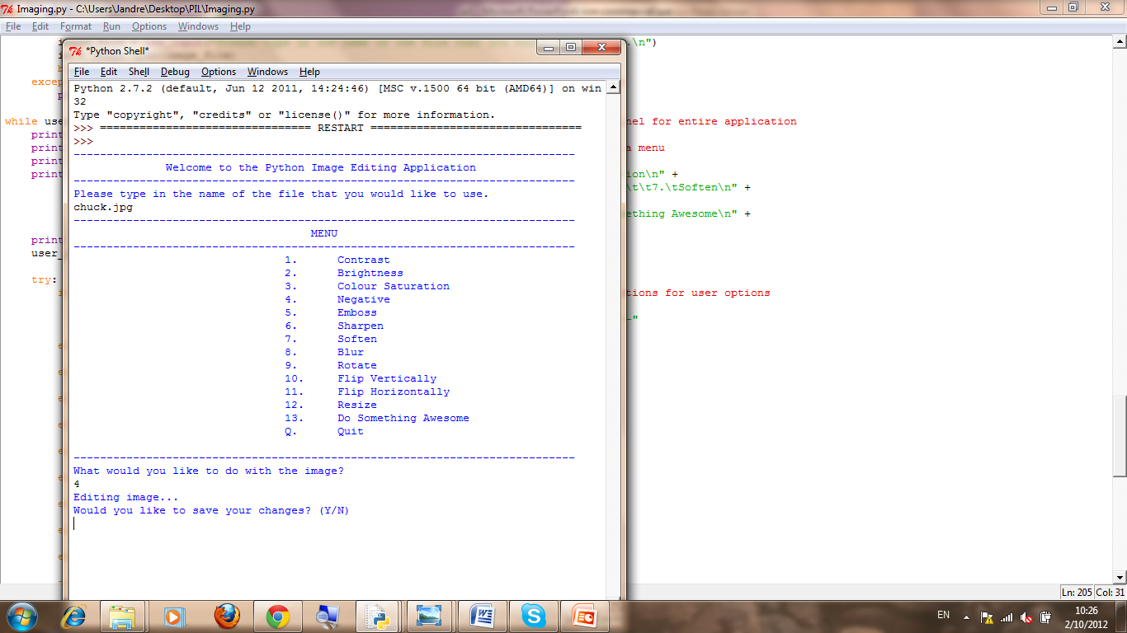
Program run Sequence
Program performs selected enhancement/filter
Then asks if the user is satisfied or not
Notes:
Next: Chuck!

Slide 7
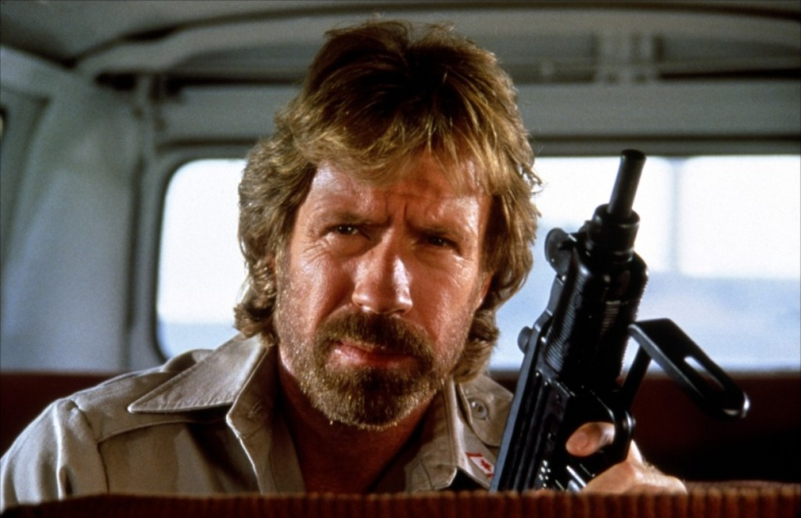
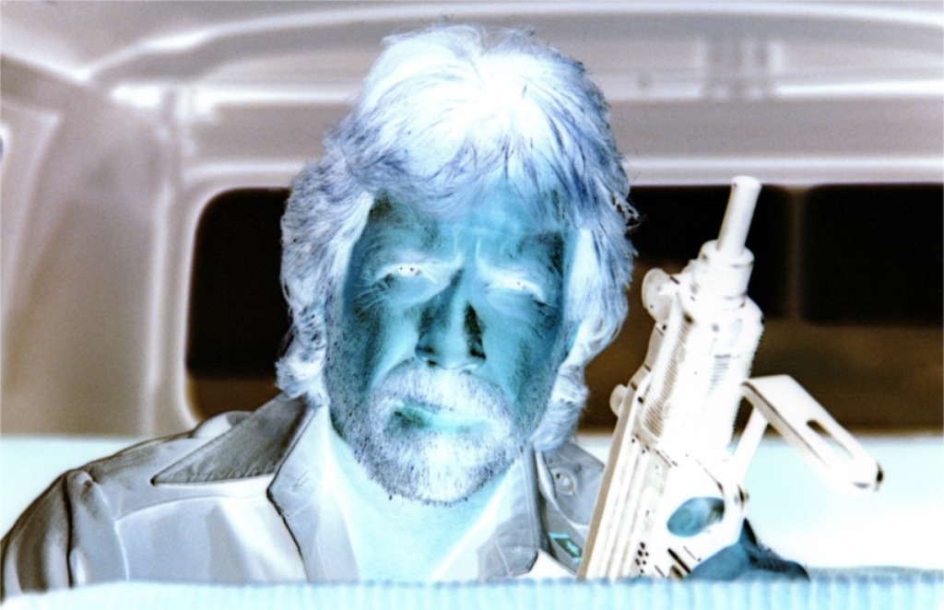
Notes:
Next Save

Slide 8
Program run Sequence
The user can choose to save the edited picture as a new file or overwright the original and continue editing.
This allows multiple editing on a single picture
Notes:
The user can choose to save the edited picture as a new file or overnight the original and continue editing.
This allows multiple editing on a single picture
Next: satisfied

Slide 9
Program run Sequence
If satisfied = picture saved as is and program returns to main menu
If not satisfied = current alteration is not added to picture and menu returns.

Slide 10

